Slide 1

Oral Communication Listening Skills

Slide 2

The Power of Listening
Notes:
Have you ever heard the proverbial expression, “God gave us two ears and one mouth so we ought to listen twice as much as we speak…”?
Listening is a critical skill for all adults to have, to learn about others. Also, it is one of the most valuable tools for you to establish a strong rapport with employees.
In today's high-tech, high-speed, high-stress world, communication is more important then ever, yet we seem to devote less and less time to really listening to one another.
Genuine listening has become a rare gift—the gift of time. It helps build relationships, solve problems, ensure understanding, resolve conflicts, and improve accuracy.
At work, effective listening means fewer errors and less wasted time. At home, it helps develop resourceful, self-reliant kids who can solve their own problems.
Listening builds friendships and careers. It saves money and marriages.

Slide 3

What is Listening?
Listening: The process of receiving, constructing meaning from, and responding to spoken and/or nonverbal messages; to hear something with thoughtful attention
Effective communication is 2-way
Depends on speaking and listening
Notes:
Listening is receiving language through the ears. Listening involves identifying the sounds of speech and processing them into words and sentences. When we listen, we use our ears to receive individual sounds (letters, stress, rhythm and pauses) and we use our brain to convert these into messages that mean something to us.
Listening in any language requires focus and attention. It is a skill that some people need to work at harder than others. People who have difficulty concentrating are typically poor listeners. Listening in a second language requires even greater focus.
Like babies, we learn this skill by listening to people who already know how to speak the language. This may or may not include native speakers. For practice, you can listen to live or recorded voices. The most important thing is to listen to a variety of voices as often as you can.

Slide 4


Listening vs. Hearing
Hearing- physical process; natural; passive
Listening- physical & mental process; active; learned process; a skill
Listening is hard!
You must choose to participate in the process of listening.
Notes:
The difference between hearing and listening is that hearing is the process of taking in noise and sound, whereas listening is when an individual tries to understand what they are hearing. Hence, listening is different from hearing because it requires more conscious action.

Slide 5
Fast Facts
We listen at 125-250 wpm, think at 1000-3000 wpm
75% of the time we are distracted, preoccupied or forgetful
20% of the time, we remember what we hear
More than 35% of businesses think listening is a top skill for success
Less than 2% of people have had formal education with listening
Notes:
We listen at 125-250 wpm, think at 1000-3000 wpm
75% of the time we are distracted, preoccupied or forgetful
20% of the time, we remember what we hear
More than 35% of businesses think listening is a top skill for success
Less than 2% of people have had formal education with listening

Slide 6



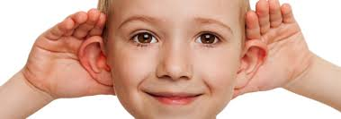
Percentage of Communication
Mode of Communication | Formal Years of Training | Percentage of Time Used
Writing | 12 years | 9%
Reading | 6-8 years | 16 %
Speaking | 1-2 years | 30%
Listening | 0-few hours | 45%
Notes:
Listening: Learned first, Used most (45%), Taught least. (As we born we start listening)
Speaking: Learned second, Used next most (30%), Taught next least. ( With the recognition of words we start speaking)
Reading: Learned third, Used next least (16%), Taught next most.
Writing: Learned fourth, Used Least (9%), Taught most.

Slide 7
Why Be A Good Listener?
Need of the Customers…
To be recognized and remembered
To feel valued
To feel appreciated
To feel respected
To feel understood
To feel comfortable about a want or need
Notes:
Effective communication can make you an effective leader and success can come much easier. Communication is significant to build resilience and it also maintains balance in different aspect of your life. Communication is the base of almost everything in life. In order to make someone else understand you, it is very important to be a confident and efficient communicator. There will be fewer chances of misunderstanding if there is a clear and crisp communication. However, in order to become an effective communicator, you need to be an effective and good listener. Many situations come in the daily life which needs communication; otherwise, they can become extremely complicated.
If you are not a good listener, you won’t be able to understand the point of view of another person. There are very few situations when you can consider just talking from your end. However, most situations require effective listening skills. We really need to understand the importance of listening at a broader level. Most of the people generally avoid the skill of listening. Though, communication is never complete process without being a good listener and alone being a good speaker. You may be very good in portraying your thoughts effectively, however, if you are not good at understanding other’s point of view it will never be considered effective communication.

Slide 8
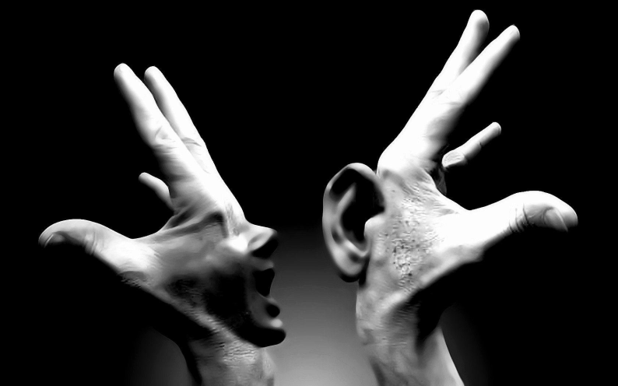
Listening is the most powerful form of acknowledgment …a way of saying, “You are important.”
Notes:
If you're interested in raising the bar for innovation in your organization, start listening more. Listening, quite simply, is the most powerful form of influence.
An even deeper layer of the power of listening is that it creates a space, or container, for the other person's truth to be captured. The deeper and more attentive the listening, the deeper the truth. It's as if the listening "pulls out" the truth. The power of this level of listening hasn't even begun to be considered, for the most part, but I believe that it is one of the least used, and understood, "super-powers" that humans possess.

Slide 9

Listening builds stronger relationships …creates a desire to cooperate among people because they feel accepted and acknowledged.
Notes:
When we give our full attention to people expressing thoughts and experiences that are important to them, they are likely to see us as a person who cares about them.
When we are obviously focusing on that person and we refrain from interjecting opinions, judgments, and advice, or finishing their sentences, we are seen as someone who cares and can be trusted with their information and confidences. This builds trust.
When we listen properly to the other person’s point of view a real conversation can ensure. An educated and informed conversation can take place rather than sound bites being picked on and conclusions jumped too. When this genuine exchange takes place, we naturally form a relationship.

Slide 10

Listening promotes being heard …”Seek first to understand, then be understood.”
- Stephen Covey
Notes:
The most basic of all human needs is the need to understand and be understood. The best way to understand people is to listen to them.

Slide 11

Listening creates acceptance and openness …conveys the message that “I am not judging you.”
Notes:
Listening creates acceptance and openness …conveys the message that "I am not judging you.”
Open-mindedness is critical to job success. Supervisors want to know that you have a willingness to learn new things and consider alternative approaches to problem-solving. In an interview, showing you are open-minded instils confidence in the hiring manager that you are teachable and coachable. Someone who projects a know-it-all attitude is often a turn off. Also, the hiring manager wants to know that you have a cooperative attitude and listen well to others when they share their opinions.

Slide 12

Listening leads to learning …openness encourages personal growth and learning

Slide 13

Listening reduces stress and tension …minimizes confusion and misunderstanding, eliminating related stress and tension
Notes:
Music is all about a feeling. It has always been an emotional high for me since as far back as I can remember.
Do you ever notice that when your favourite song is on you feel awesome? Ever notice how some songs make you feel sad or remind you of something or someone in your past? It’s like you are immediately caught in that certain moment. That’s the neurological and emotional effects of music on you.
Communicating is not just about expressing ourselves verbally; it is also about having strong listening skills. It is a two way street, and the way you communicate determines what others think of you and how you are accepted and appreciated.
Being a good listener means you have to stop talking and listen. It means you do not think about other things and that you avoid distractions. It also means that you do not start forming an opinion or start thinking of an answer or rebuttal to the sender of the message before they finish delivering it. To do this you have to involve all your senses and skills to understand the person.

Slide 14
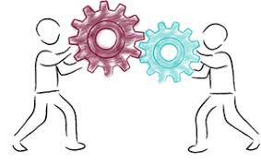
Listening is CRITICAL in conflict resolution
…much conflict comes from the need to be heard. Successful resolution depends on being a non-anxious presence.
Notes:
Dealing with complaints or conflict, your role as a listener is
● To be impartial
● Create a positive and 'safe' confidential environment
● Help the speaker tell what is important to them
● Acknowledge experiences, concerns, needs and values

Slide 15

Barriers to Listening
Equate With Hearing
Uninteresting Topics
Speaker’s Delivery
External Distractions
Mentally Preparing Response
Listening for Facts
Personal Concerns
Personal Bias
Language/Culture Differences
Faking Attention
Notes:
The barriers of listening are nothing but the facts that are lowering or reducing the listening

Slide 16
Bad Listening Habits
Criticizing the subject or the speaker
Getting over-stimulated
Listening only for facts
Not taking notes OR outlining everything
Tolerating or creating distraction
Letting emotional words block message
Wasting time difference between speed of speech and speed of thought
Notes:
Criticizing the subject or the speaker
Getting over-stimulated
Listening only for facts
Not taking notes OR outlining everything
Tolerating or creating distraction
Letting emotional words block message
Wasting time difference between speed of speech and speed of thought

Slide 17



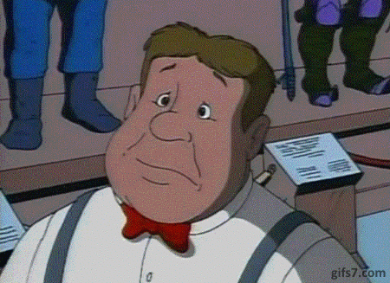
When Are You Listening?
Non-Verbal Encouragers
Notes:
Non-verbal encouragers are the facts the make you to listen something with emotional expressions or body language and not by vocal communication

Slide 18
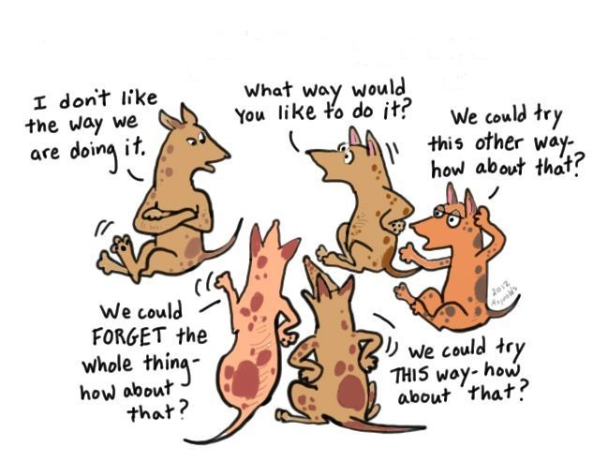
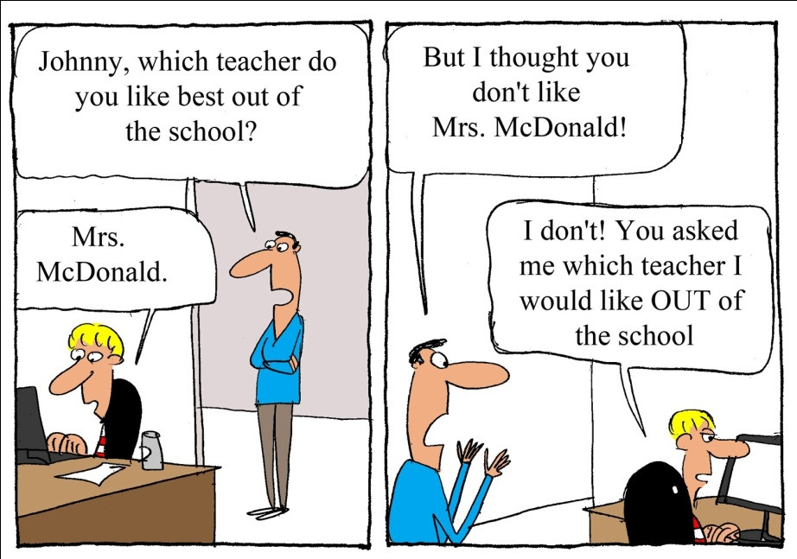
When Are You Listening?
Verbal Encouragers
Notes:
Verbal encouragers are the facts that make you to understand something through vocal or dialog communication

Slide 19
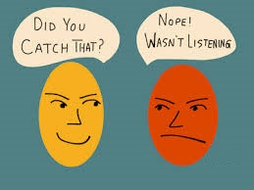
Active Listening
… Allows you to make sure you hear the words and understand the meaning behind the words
Goal: go beyond listening to understanding
Notes:
Allows you to make sure you hear the words and understand the meaning behind the words

Slide 20
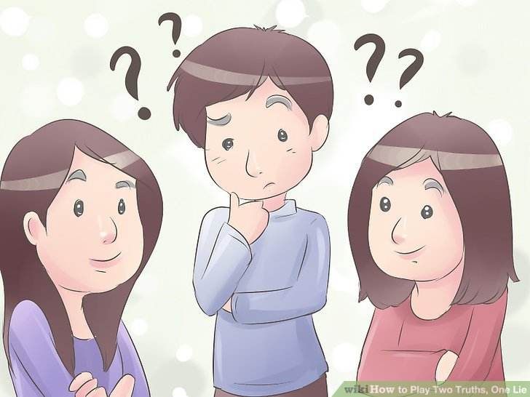
Two Truths and a Lie Game
Notes:
Well Two Truths and a Lie game works perfectly with smaller groups of people. First, every member in the group is asked to form a circle. Once the circle has been formed, paper and pens are distributed and each member would write on the paper, three statements about them in which two of these statements are true and one statement is a lie. Now, the first person in the group reads out loud those three statements at once. Then he/she reads each statement again and asks other people in the group to vote which statement they think is true and which statement is false. One of the members in the group can also participate as a moderator to keep track of the scores by writing it on the paper. The person with the highest score wins the game!

Slide 21
Thanking you

